Slide 1
Statistics, Data Mining, and Machine Learning in Astronomy
Andrew Connolly, Brigitta Sipocz, Zeljko Ivezic
University of Washington

Slide 2
Welcome
DATE: Monday, 6 January 2020
TIME: 13:00 - 17:00pm
LOCATION: ROOM 323 A at the Hawai'i Convention Center
This workshop will introduce the astronomical community to the 2nd edition of the book Statistics, Data Mining, and Machine Learning in Astronomy and the associated software package astroML. The goal is to introduce participants to a variety of statistical and machine learning tools available within the open source astroML library. The format will be interactive, including short presentations on different machine learning methodologies followed by instructor-guided, Jupyter notebook based tutorials. In these tutorial sessions participants will be able to try out the tools and to ask questions from expert users and developers. Our primary focus will be on the new material and applications in the 2nd edition of the book.

Slide 3
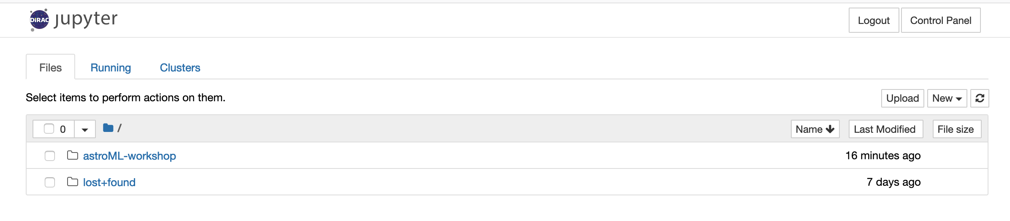
While we discuss astroML
http://astroml.dirac.institute
Enter your GitHub credentials
Start the server
If successful you should see (select the astroML-workshop folder)

Slide 4
Outline of this workshop
Brief introduction to astroML and the changes
Whats new in astroML (Andy Connolly)
Hierarchical Bayes (Zeljko Ivezic)
Approximate Bayesian Computation (Zeljko Ivezic)
Regression with Uncertainty (Brigitta Sipocz)
Deep Learning examples (Andy Connolly)
The next year(s) of development

Slide 5
AstroML: is a Python module for machine
learning and data mining built on numpy,
scipy, scikit-learn, matplotlib, and astropy,
and distributed under the 3-clause BSD license. It contains a growing library of statistical and machine learning routines for analyzing astronomical data in Python, loaders for several open astronomical datasets, and a large suite of examples of analyzing and visualizing astronomical datasets.

Slide 6
What is new in astroML
https://github.com/astroML/astroML
Brigitta Sipocz is the new maintainer of astroML
Release v0.4 and new edition of the book
Updated to latest versions of scikit-learn, astropy, numpy, scipy
Ended Python 2 support
Included ipython notebook examples for:
Approximate Bayesian Computation
Hierarchical Bayes
Neural Networks
Convolutional Neural Networks
Autoencoders (variational)

Slide 7
The year(s) ahead
Development of astroML
We see astroML becoming a community driven package for machine learning tools that can be shared and (eventually) moved into more stable organizations such as scikit-learn and astropy (see the development of the time series period finding code)
In the next year we expect to release a package for regression that works on data with errors in all variables (see preview here); creation of deep learning examples and architectures; example packages for scaling machine learning using dask and spark; and transition of our example code into ipython notebooks
We would welcome ideas for areas you would like to see developed (or would like to help develop)

